Slide 1
Practice MCQs
Session-1

Slide 2
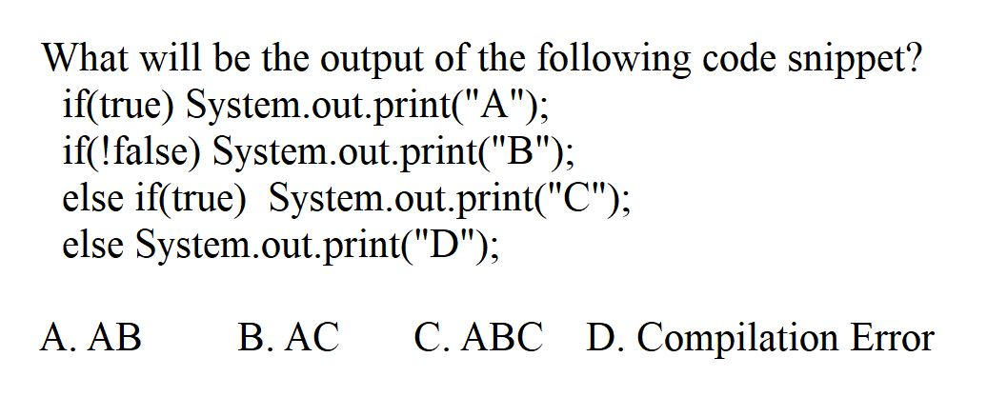
Q1

Slide 3
Q1
A

Slide 4
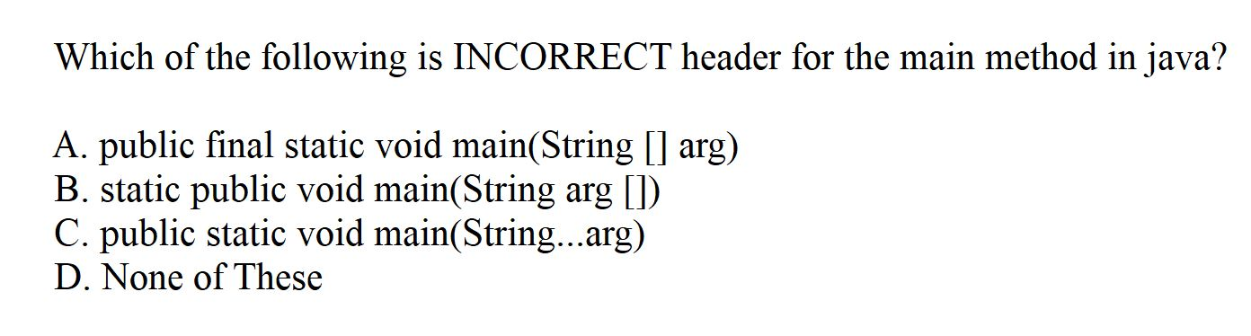
Q2

Slide 5
Q2
D

Slide 6
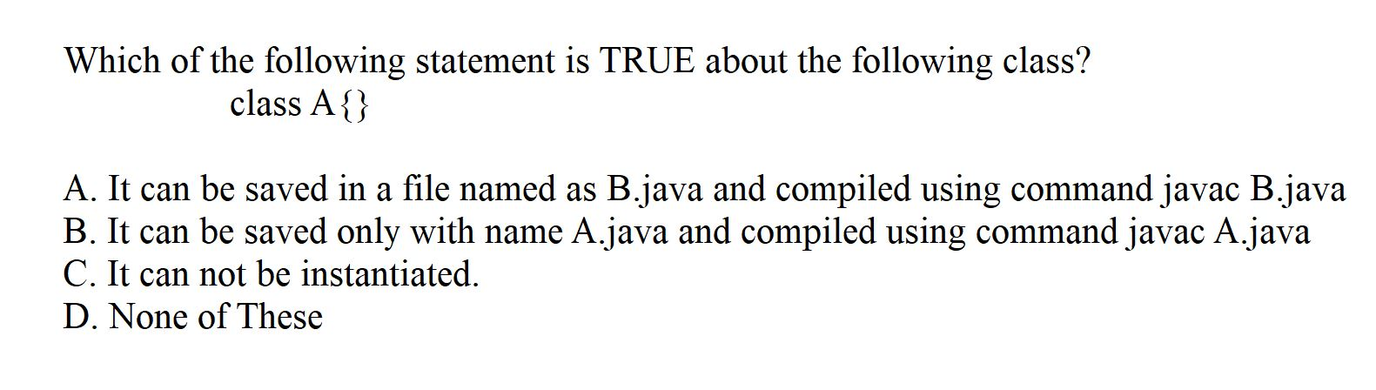
Q3

Slide 7
Q3
A

Slide 8
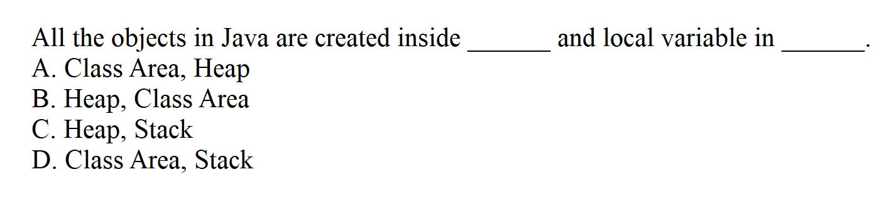
Q4

Slide 9
Q4
C

Slide 10
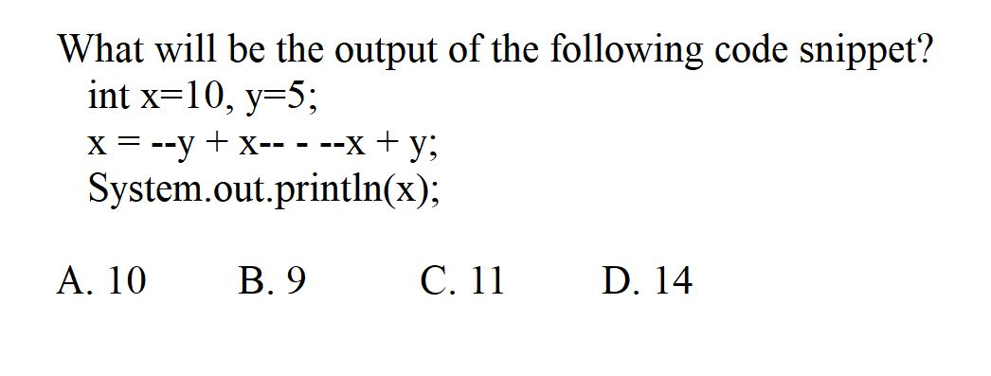
Q5

Slide 11
Q5
A

Slide 12
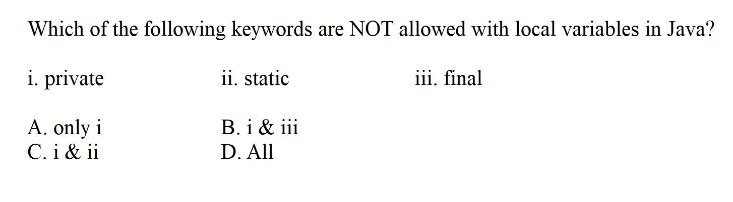
Q6

Slide 13
Q6
C

Slide 14
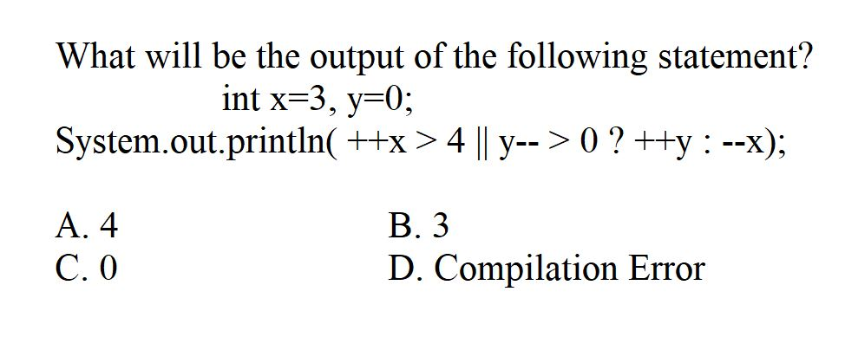
Q7

Slide 15
Q7
B

Slide 16
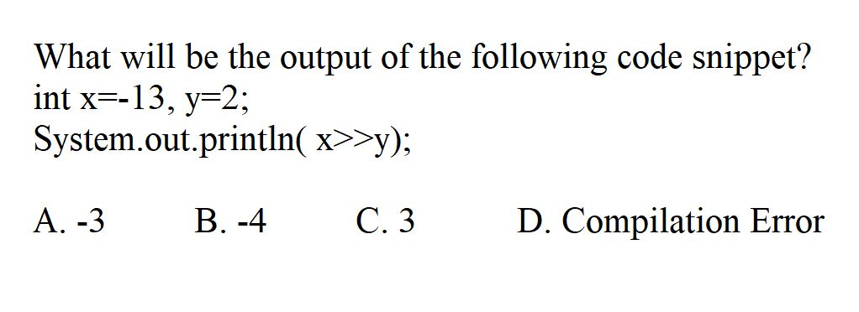
Q8

Slide 17
Q8
B

Slide 18
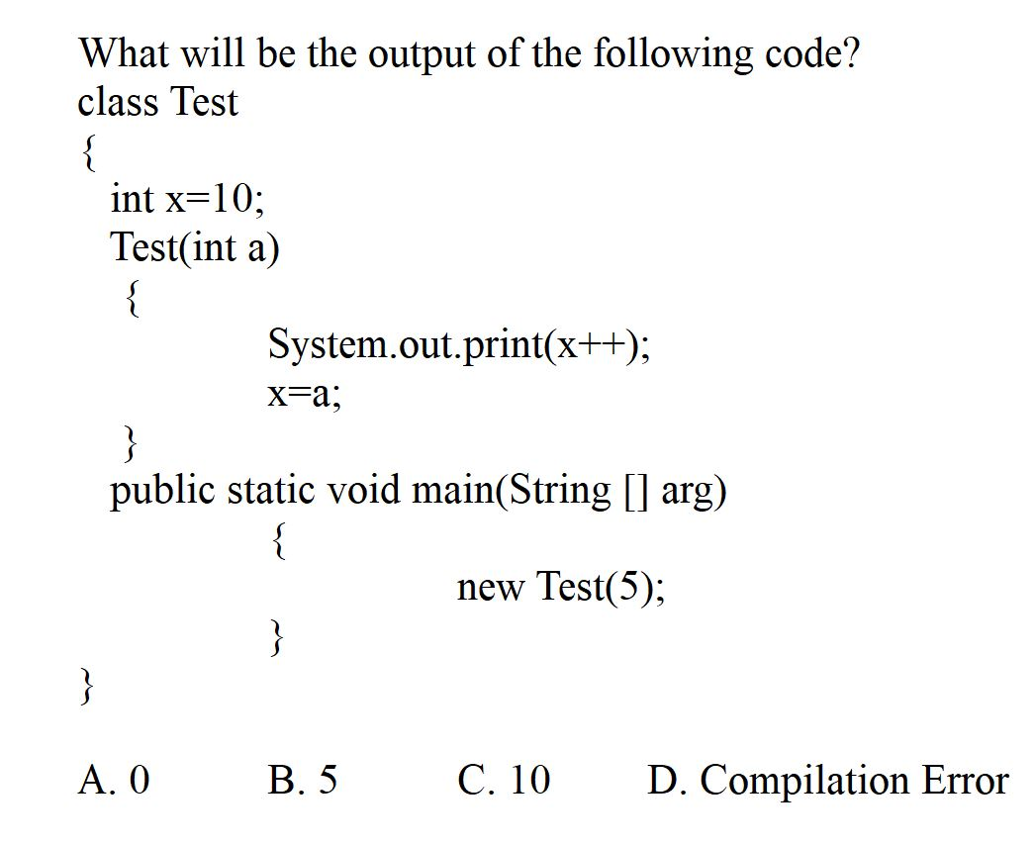
Q9

Slide 19
Q9
C

Slide 20
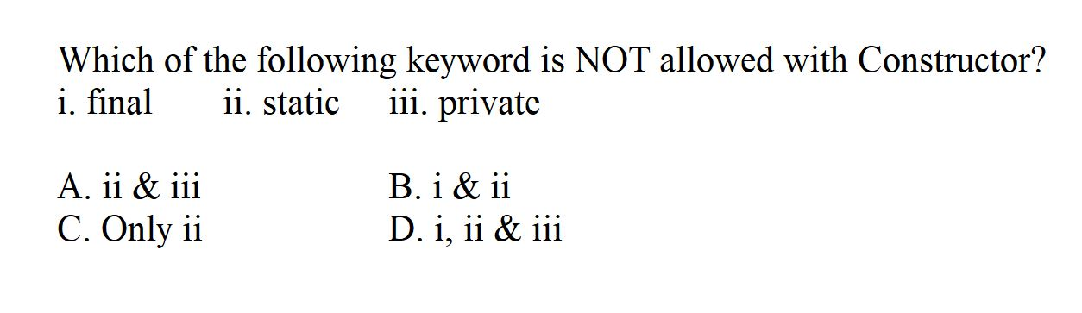
Q10

Slide 21
Q10
B

Slide 22
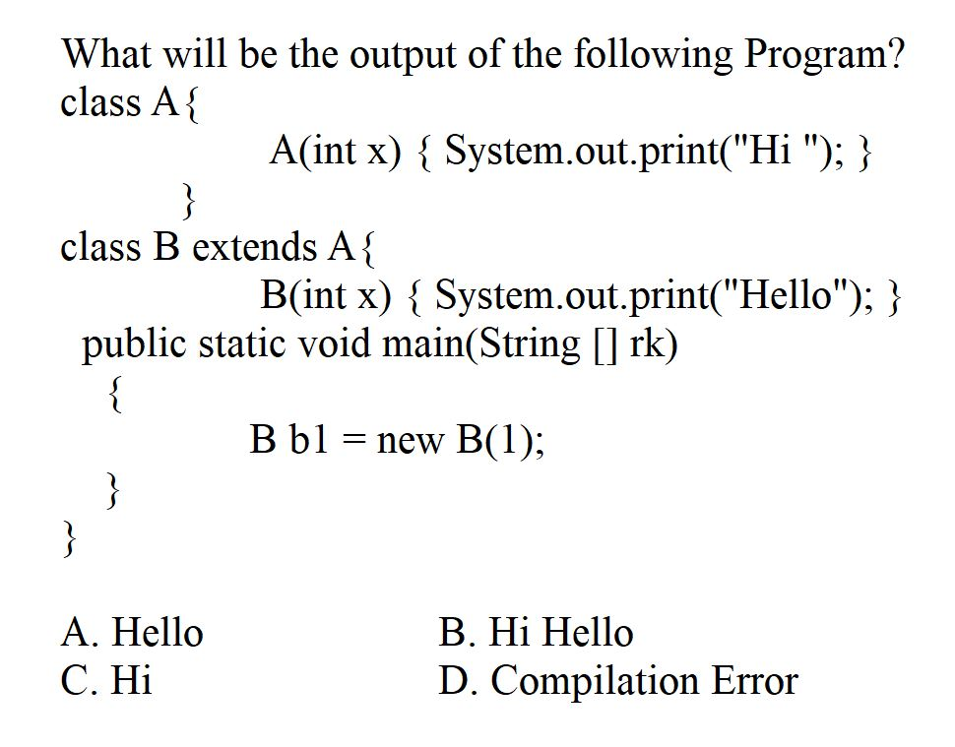
Q11

Slide 23
Q11
D

Slide 24
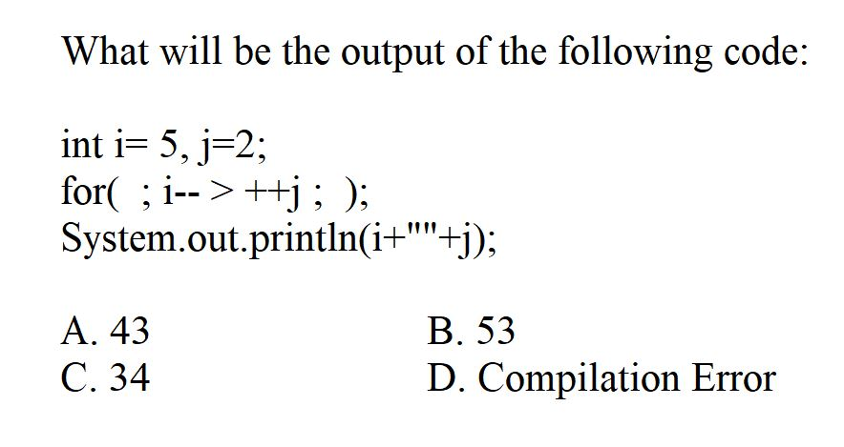
Q12

Slide 25
Q12
C

Slide 26
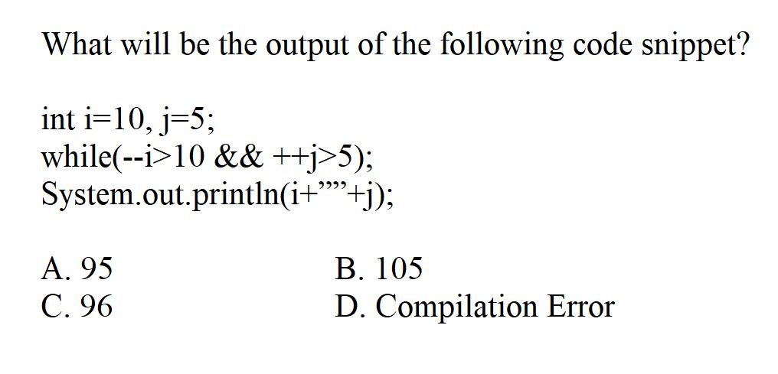
Q13

Slide 27
Q13
A

Slide 28
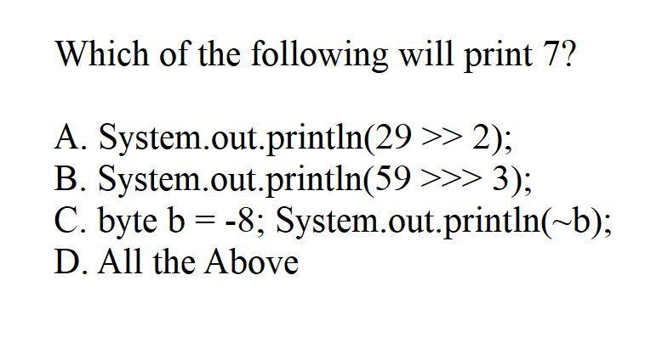
Q14

Slide 29
Q14
D

Slide 30
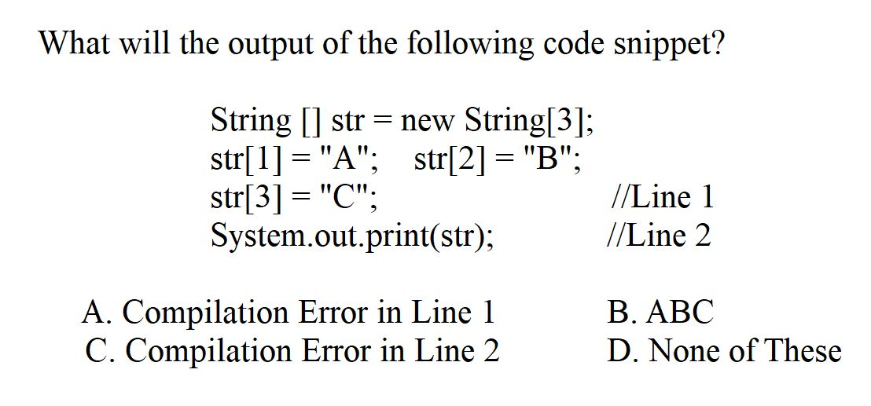
Q15

Slide 31
Q15
d

Slide 32
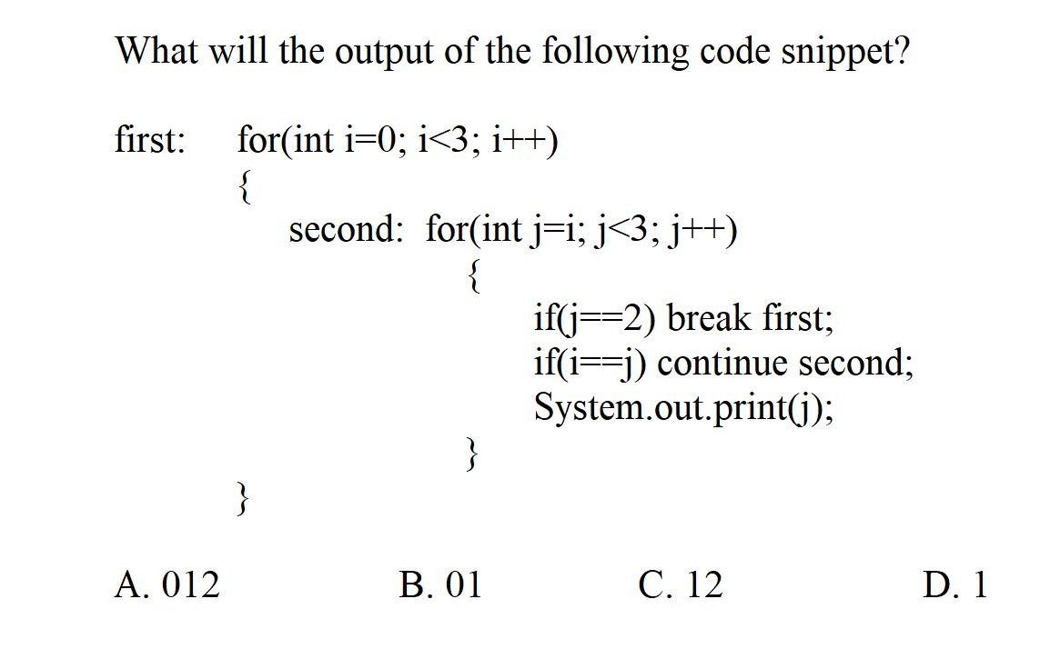
Q16

Slide 33
Q16
D

Slide 34
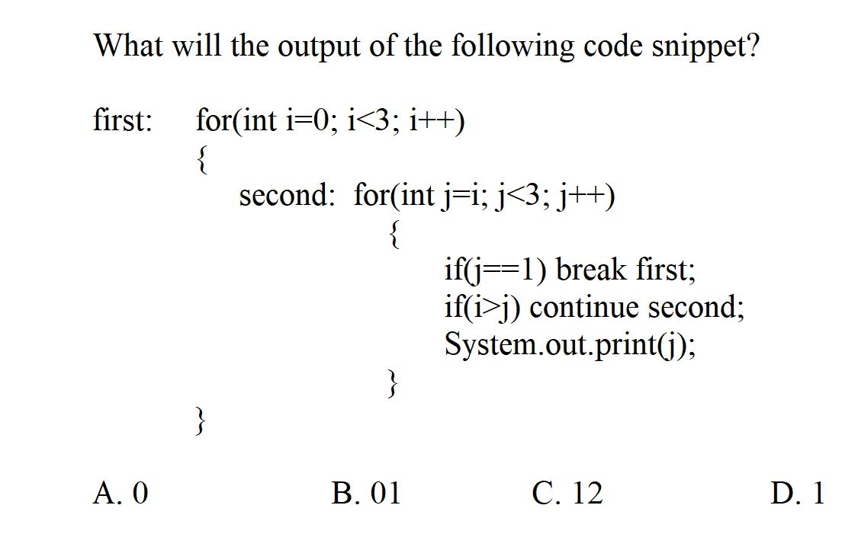
Q17

Slide 35
Q17
A

Slide 36
Q18
public class Task
{
public static void main(String[] args) {
int x=5,y=1;
if(x++>5)
{
if(y<2)
System.out.println("Hi");
else
System.out.println("Bye");
}
else
System.out.println(x);
}
}
A. 6 B. Hi C. Bye D. 5

Slide 37
Q18
public class Task
{
public static void main(String[] args) {
int x=5,y=1;
if(x++>5)
{
if(y<2)
System.out.println("Hi");
else
System.out.println("Bye");
}
else
System.out.println(x);
}
}
A. 6 B. Hi C. Bye D. 5

Slide 38
Q19
public class Task
{
public static void main(String[] args) {
int x=5,y=1;
if(++x>5)
if(++y<2)
System.out.println("Hi");
else
System.out.println("Bye");
else
System.out.println("Hello");
}
}
A. Hi B. Bye C. Hello D. Blank Output

Slide 39
Q19
public class Task
{
public static void main(String[] args) {
int x=5,y=1;
if(++x>5)
if(++y<2)
System.out.println("Hi");
else
System.out.println("Bye");
else
System.out.println("Hello");
}
}
A. Hi B. Bye C. Hello D. Blank Output

Slide 40
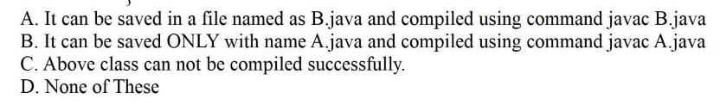
Q20
Which of the following is true about the following class?
public class A
{
public static void main(String[] args){}
}

Slide 41
Q20
Which of the following is true about the following class?
public class A
{
public static void main(String[] args){}
}
B

Slide 42
Q21
8
12
-1
7
public class Task
{
public static void main(String[] args) {
String s1="This is the test phase";
System.out.println(s1.lastIndexOf('t',11));
}
}

Slide 43
Q21
8
12
-1
7
public class Task
{
public static void main(String[] args) {
String s1="This is the test phase";
System.out.println(s1.lastIndexOf('t',11));
}
}

Slide 44
Q22
What will be the Output of the following Code snippet?
StringBuilder sb = new StringBuilder(0); //Line 1
sb.append("Hello");
sb.ensureCapacity(8);
System.out.println(sb.capacity());
A. Compilation Error in Line 1
B. 8
C. 12
D. 5

Slide 45
Q22
What will be the Output of the following Code snippet?
StringBuilder sb = new StringBuilder(0); //Line 1
sb.append("Hello");
sb.ensureCapacity(8);
System.out.println(sb.capacity());
A. Compilation Error in Line 1
B. 8
C. 12
D. 5

Slide 46
Q23
What will be the Output of the following Code snippet?
StringBuilder sb = new StringBuilder(6);
sb.ensureCapacity(8);
sb.setLength(2); //Line1
System.out.println(sb.capacity());
A. Compilation Error in Line 1
B. 8
C. 12
D. 14

Slide 47
Q23
What will be the Output of the following Code snippet?
StringBuilder sb = new StringBuilder(6);
sb.ensureCapacity(8);
sb.setLength(2); //Line1
System.out.println(sb.capacity());
A. Compilation Error in Line 1
B. 8
C. 12
D. 14

Slide 48
Q24(Output??)
0
-1
1
false
public class Main
{
public static void main(String[] args) {
String s1="TESTING";
String s2="testing";
System.out.println(s1.compareToIgnoreCase(s2));
}
}

Slide 49
Q24(Output??)
0
-1
1
false
public class Main
{
public static void main(String[] args) {
String s1="TESTING";
String s2="testing";
System.out.println(s1.compareToIgnoreCase(s2));
}
}

Slide 50
Q25(Output)
public class Main
{
public static void main(String[] args) {
StringBuilder sb=new StringBuilder(2);
sb.append("Exam");
System.out.println(sb.capacity()+" "+sb.length());
}
}
2 2
4 2
6 4
2 4
Notes:
Answer:C

Slide 51
Q25(Output)
public class Main
{
public static void main(String[] args) {
StringBuilder sb=new StringBuilder(2);
sb.append("Exam");
System.out.println(sb.capacity()+" "+sb.length());
}
}
2 2
4 2
6 4
2 4
Notes:
Answer:C

Slide 52
Q26
What should be the minimum changes in code given below to correct it?
public class Car //Line 1
{
public abstract void addFuel(); //Line2
}
A. Line 1 should be written as abstract public class Car
B. Line 2 should be written as public void addFuel(){}
C. Line 2 should be written as public void addFuel();
D. Either A or B

Slide 53
Q26
What should be the minimum changes in code given below to correct it?
public class Car //Line 1
{
public abstract void addFuel(); //Line2
}
A. Line 1 should be written as abstract public class Car
B. Line 2 should be written as public void addFuel(){}
C. Line 2 should be written as public void addFuel();
D. Either A or B

Slide 54
Q27(Output??)
class ABC {
int x;
}
class PQR extends ABC {
int y;
}
public class Main {
public static void main(String[] args)
{
ABC obj = new PQR();
System.out.println(obj.y);
}
}
0
1
Compile time error
Runtime error
Notes:
Ans:c

Slide 55
Q27(Output??)
class ABC {
int x;
}
class PQR extends ABC {
int y;
}
public class Main {
public static void main(String[] args)
{
ABC obj = new PQR();
System.out.println(obj.y);
}
}
0
1
Compile time error
Runtime error
Notes:
Ans:c

Slide 56
Q28(Output??)
class A{}
class B extends A{
public static void main(String args[]){
A obj1=new B();
if(obj1 instanceof B)
{
B obj2=(B)obj1;
System.out.println("Hi");
}
else
{
System.out.println("Hello");
}
}
}
Hi
Hello
Compile time error
Runtime error
Notes:
Ans:Hi

Slide 57
Q28(Output??)
class A{}
class B extends A{
public static void main(String args[]){
A obj1=new B();
if(obj1 instanceof B)
{
B obj2=(B)obj1;
System.out.println("Hi");
}
else
{
System.out.println("Hello");
}
}
}
Hi
Hello
Compile time error
Runtime error
Notes:
Ans:Hi

Slide 58
Q29
A. Derived::show() called
B. Base::show() called
C. Compile time error
D. Runtime error
Output of following Java Program?
class Base {
public void show() {
System.out.println("Base::show() called");
}
}
class Derived extends Base {
public void show() {
System.out.println("Derived::show() called");
}
}
public class Main {
public static void main(String[] args) {
Base b = new Derived();;
b.show();
}
}

Slide 59
Q29
A. Derived::show() called
B. Base::show() called
C. Compile time error
D. Runtime error
Output of following Java Program?
class Base {
public void show() {
System.out.println("Base::show() called");
}
}
class Derived extends Base {
public void show() {
System.out.println("Derived::show() called");
}
}
public class Main {
public static void main(String[] args) {
Base b = new Derived();
b.show();
}
}

Slide 60
Q30
class Base {
final public void show() {
System.out.println("Base::show() called");
}
}
class Derived extends Base {
public void show() {
System.out.println("Derived::show() called");
}
}
class Main {
public static void main(String[] args) {
Base b = new Derived();
b.show();
}
}
A. Base::show() called
B. Derived::show() called
C. Compiler Error
D. Runtime Error

Slide 61
Q30
class Base {
final public void show() {
System.out.println("Base::show() called");
}
}
class Derived extends Base {
public void show() {
System.out.println("Derived::show() called");
}
}
class Main {
public static void main(String[] args) {
Base b = new Derived();
b.show();
}
}
A. Base::show() called
B. Derived::show() called
C. Compiler Error
D. Runtime Error

Slide 62
Q31
class Base {
public static void show() {
System.out.println("Base::show() called");
}
}
class Derived extends Base {
public static void show() {
System.out.println("Derived::show() called");
}
}
class Main {
public static void main(String[] args) {
Base b = new Derived();;
b.show();
}
}
A.Base::show() called
B.Derived::show() called
C.Compiler Error
D.Runtime Error

Slide 63
Q31
class Base {
public static void show() {
System.out.println("Base::show() called");
}
}
class Derived extends Base {
public static void show() {
System.out.println("Derived::show() called");
}
}
class Main {
public static void main(String[] args) {
Base b = new Derived();
b.show();
}
}
A.Base::show() called
B.Derived::show() called
C.Compiler Error
D.Runtime Error

